Slide 1



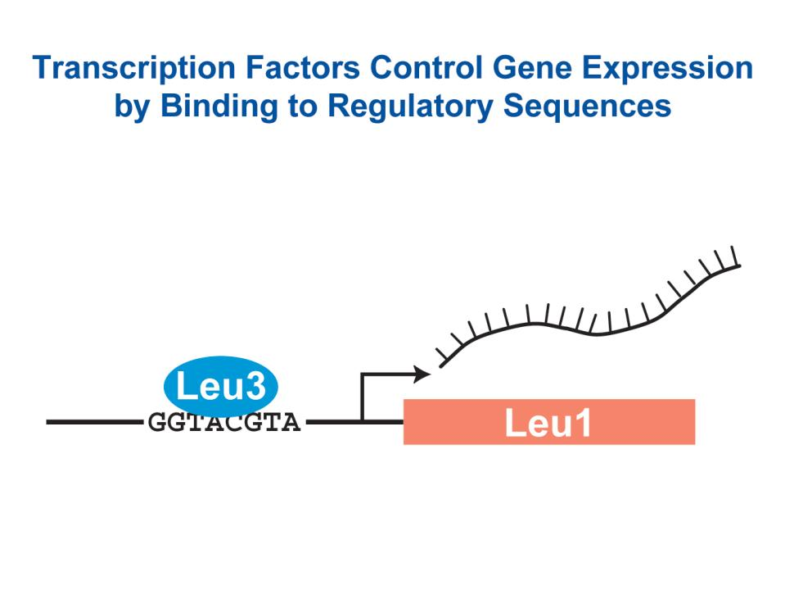
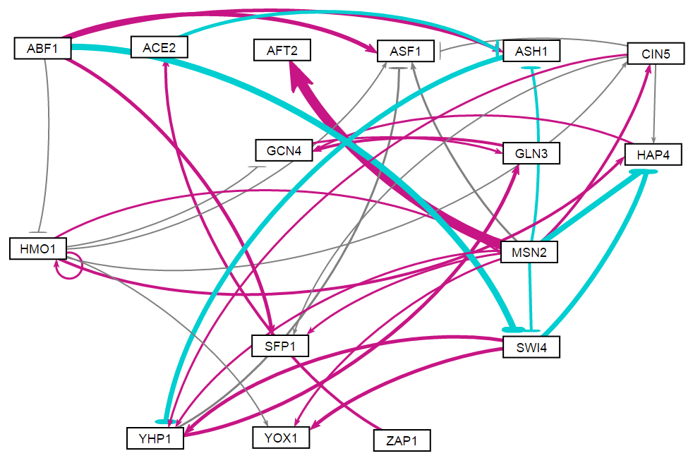
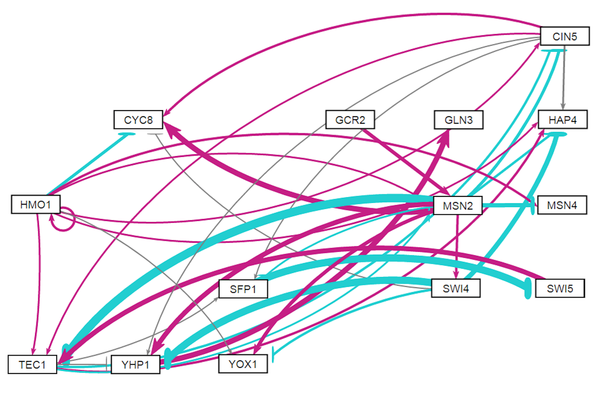
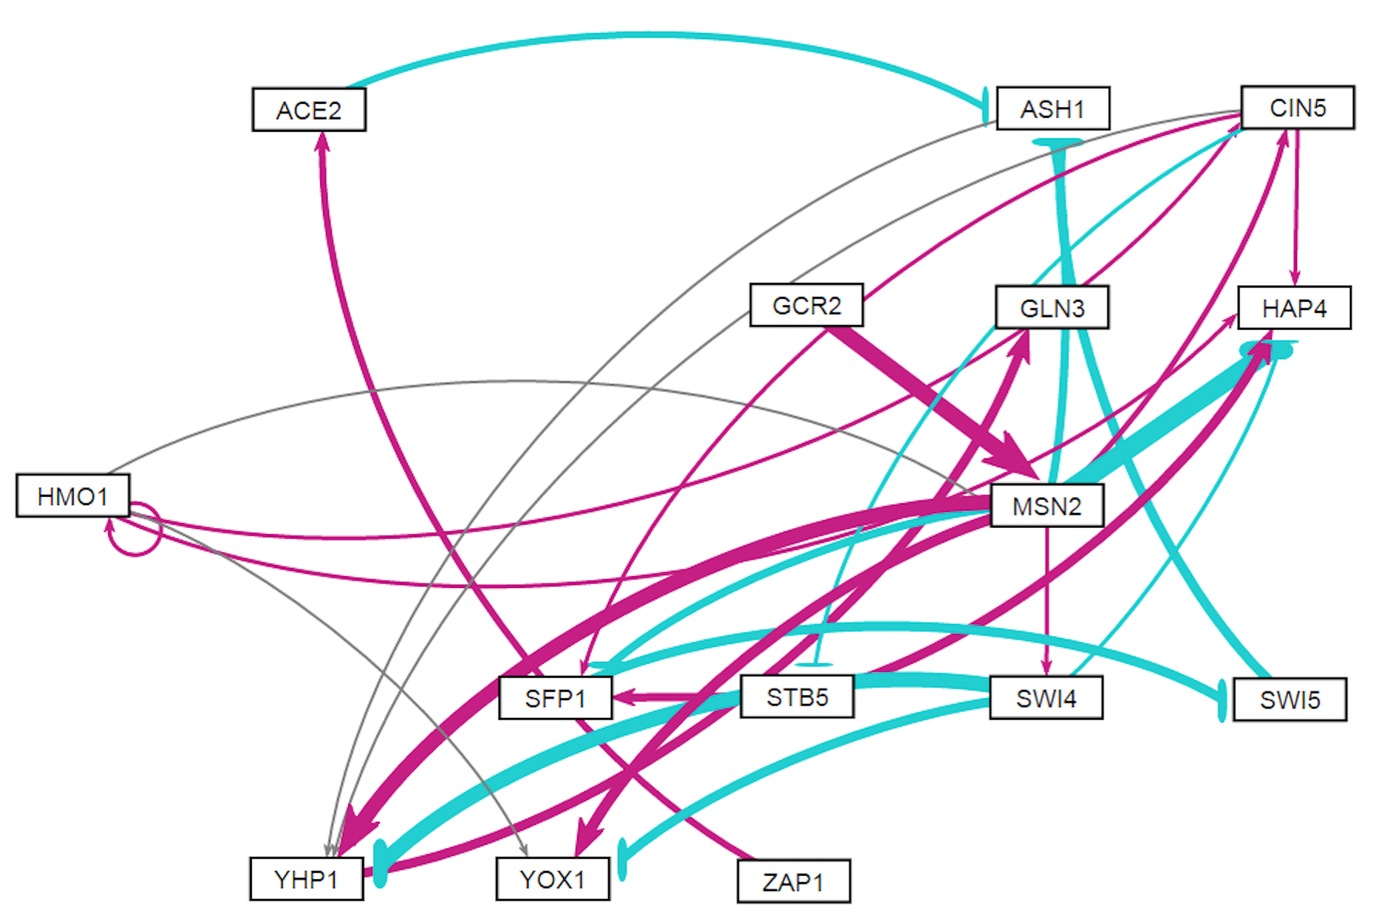
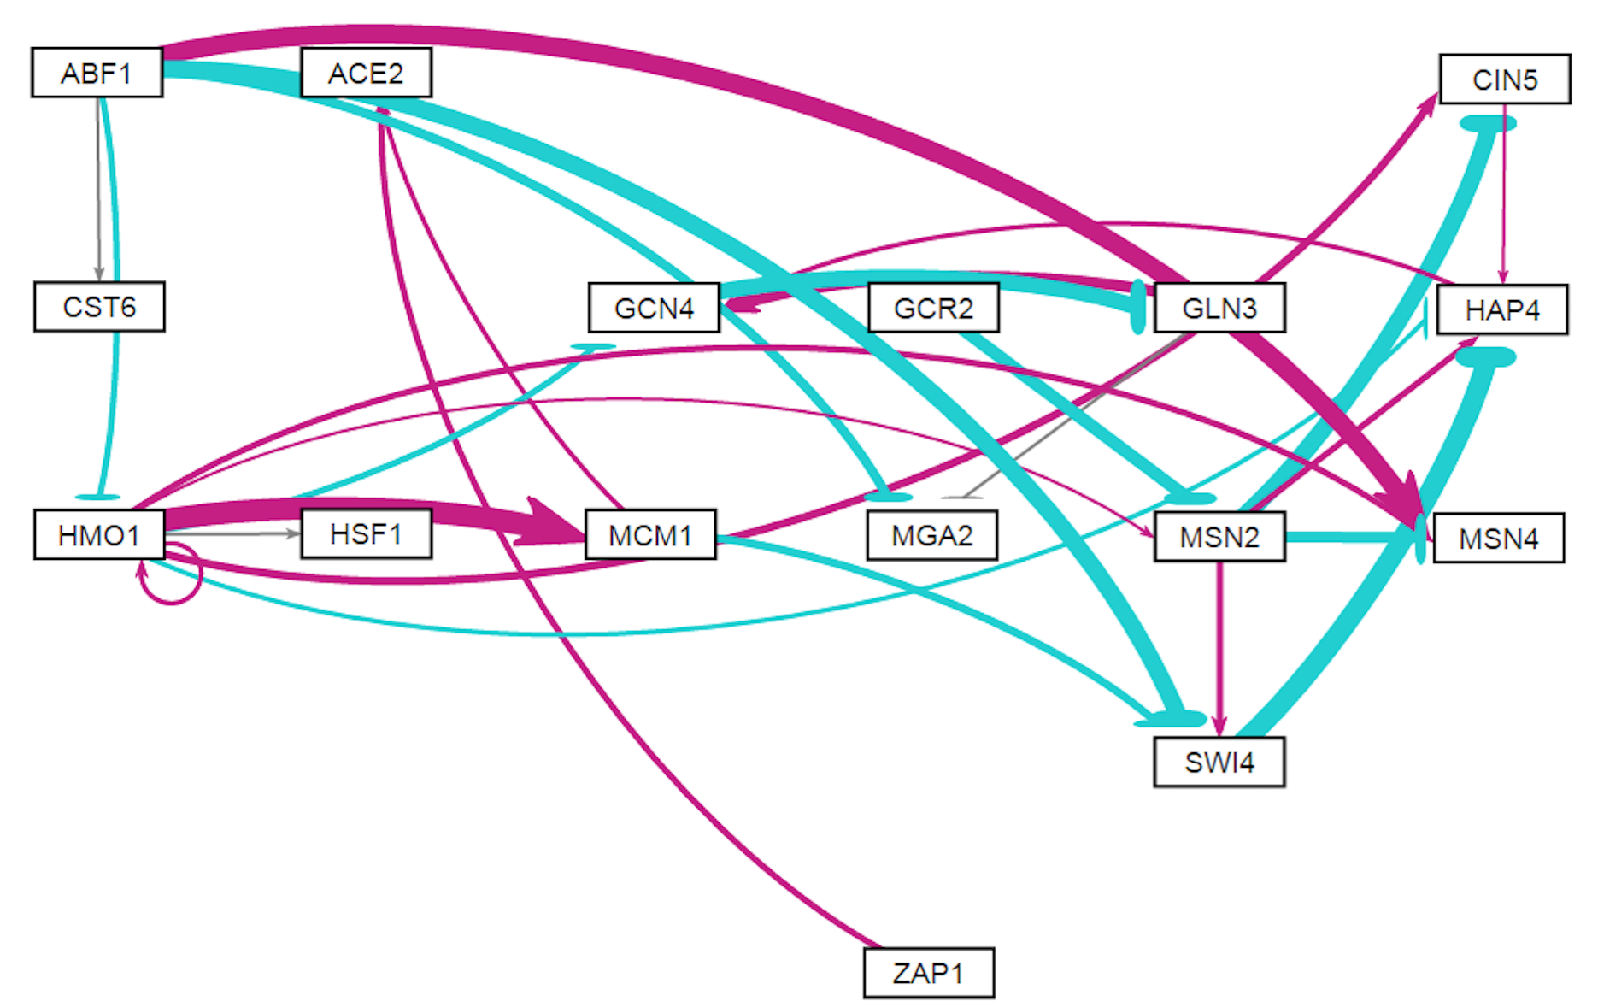
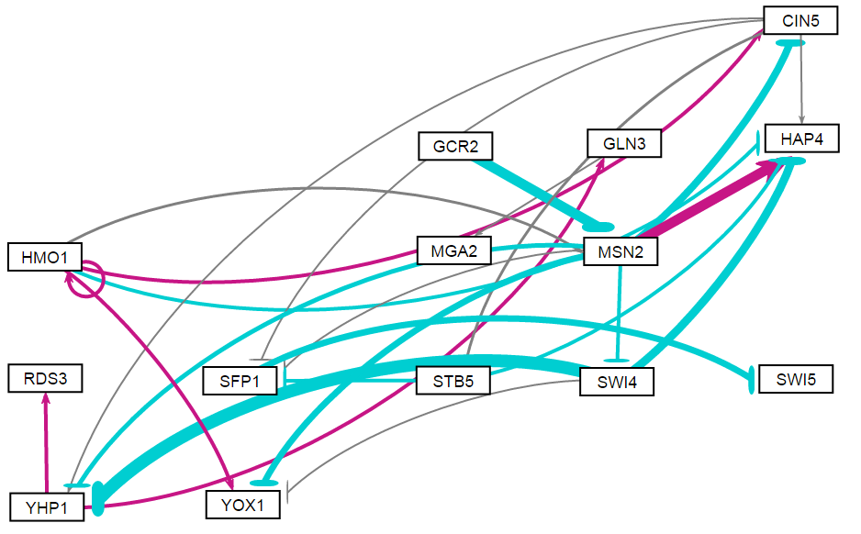
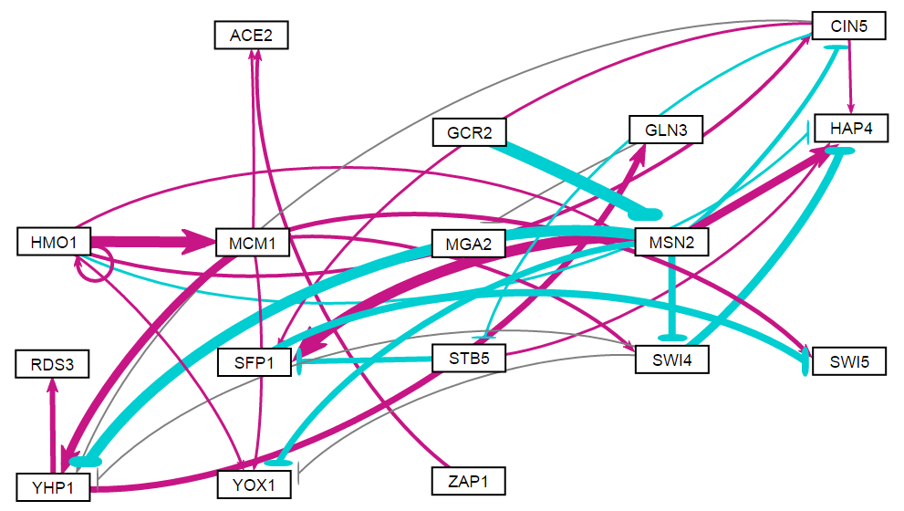
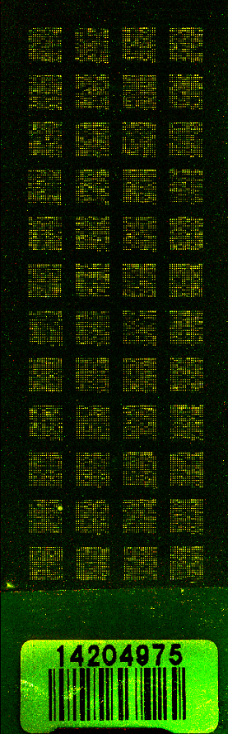
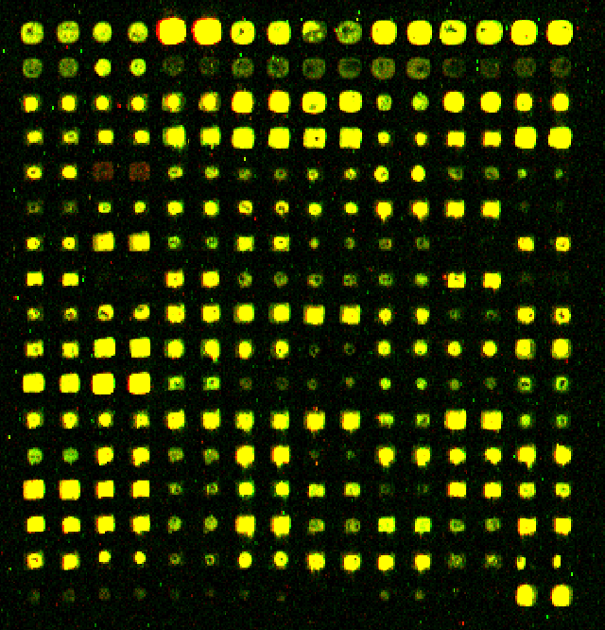
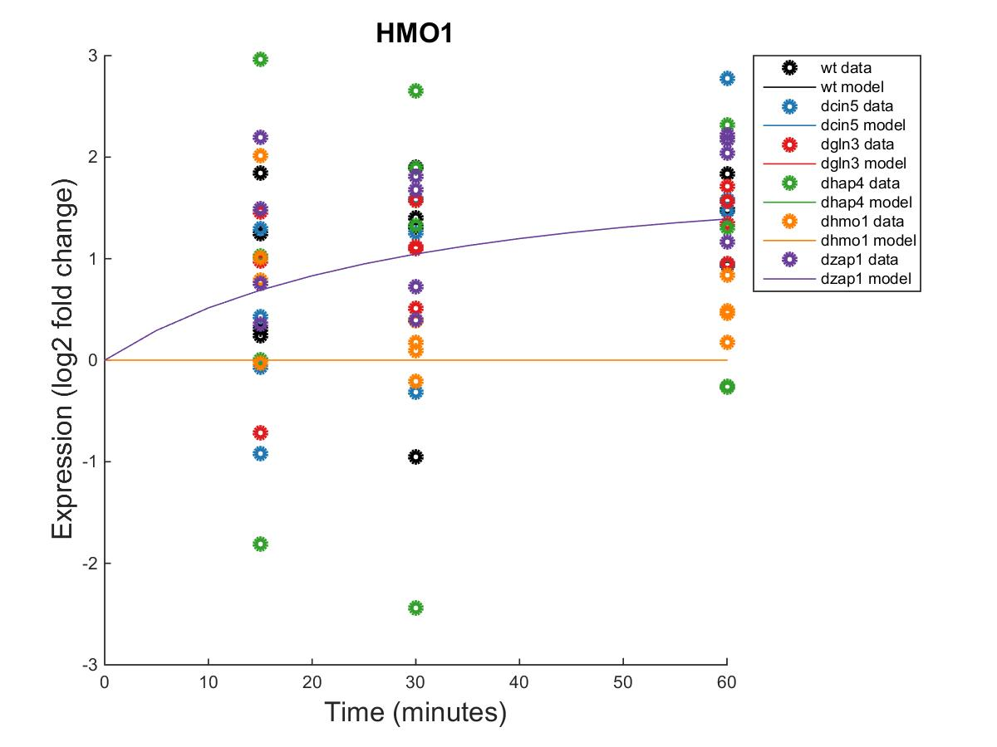
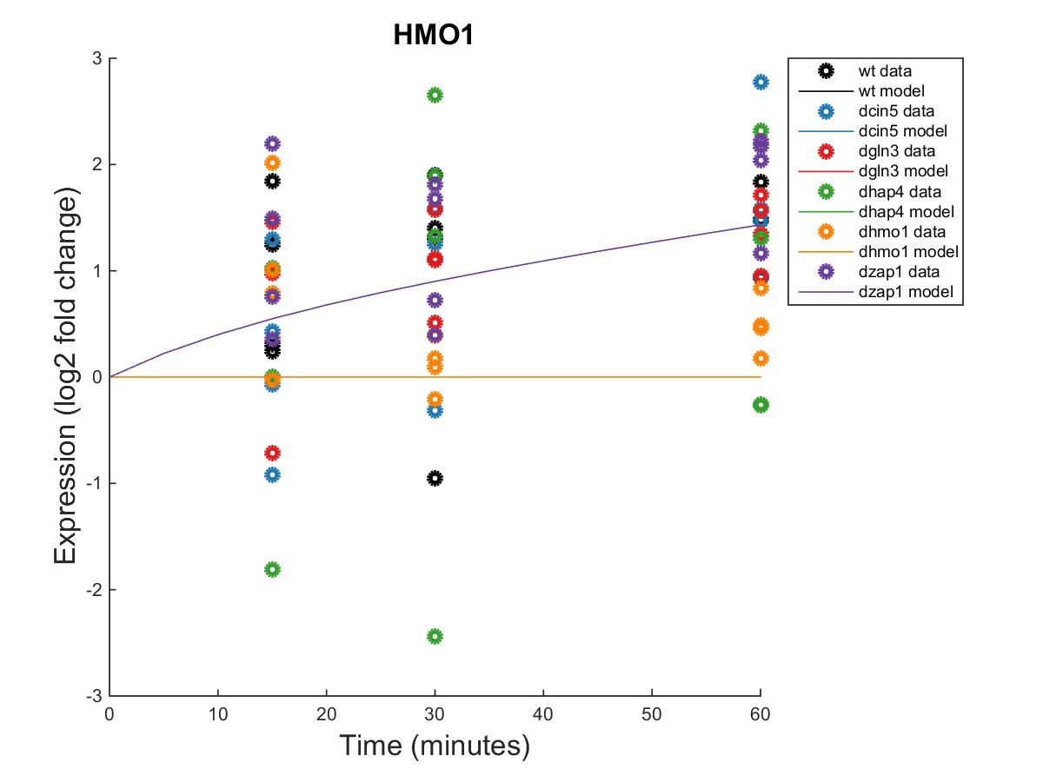
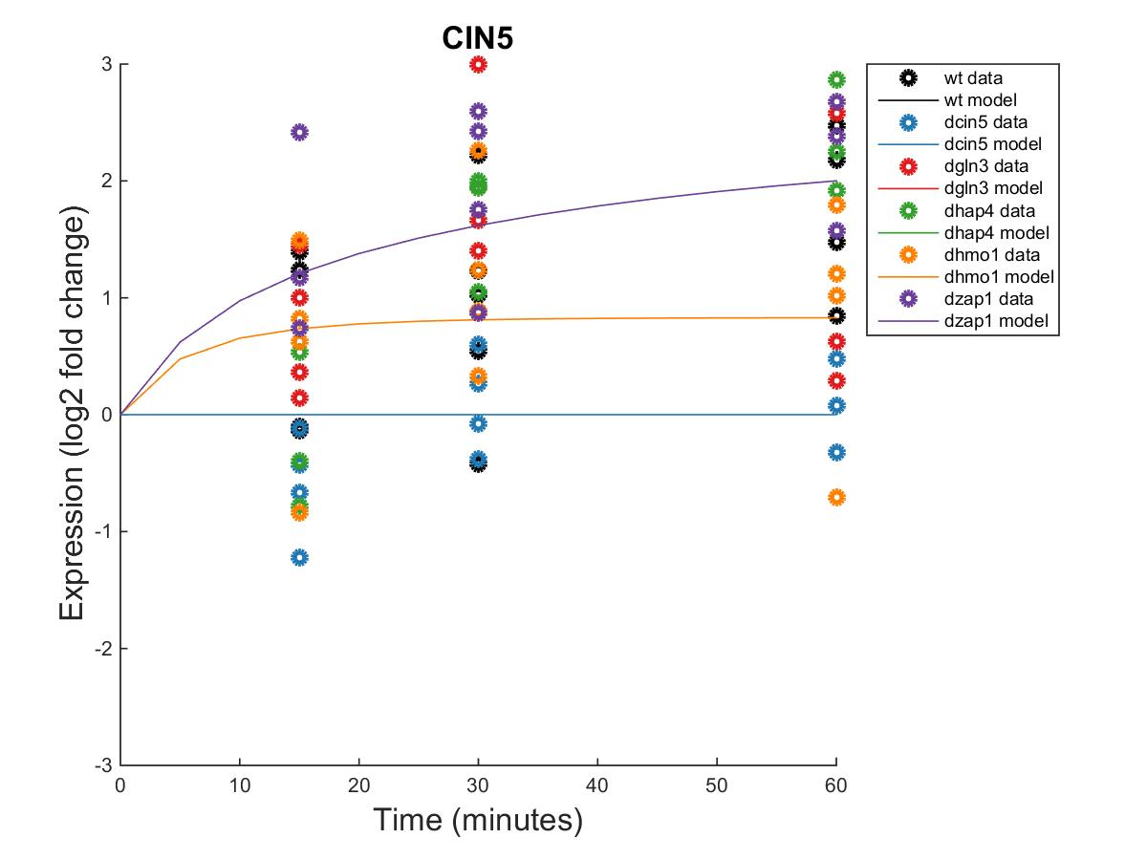
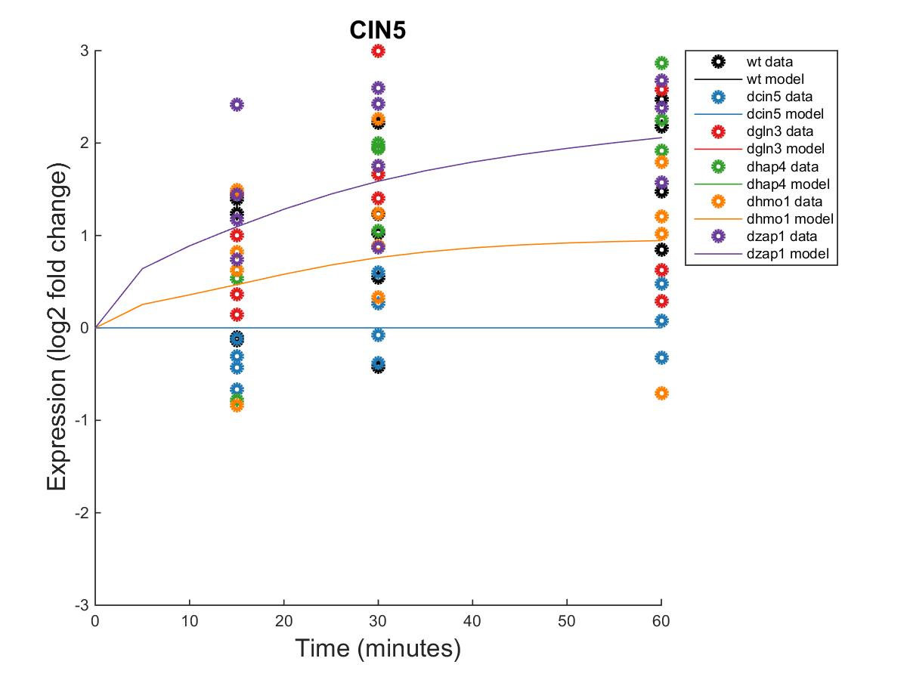
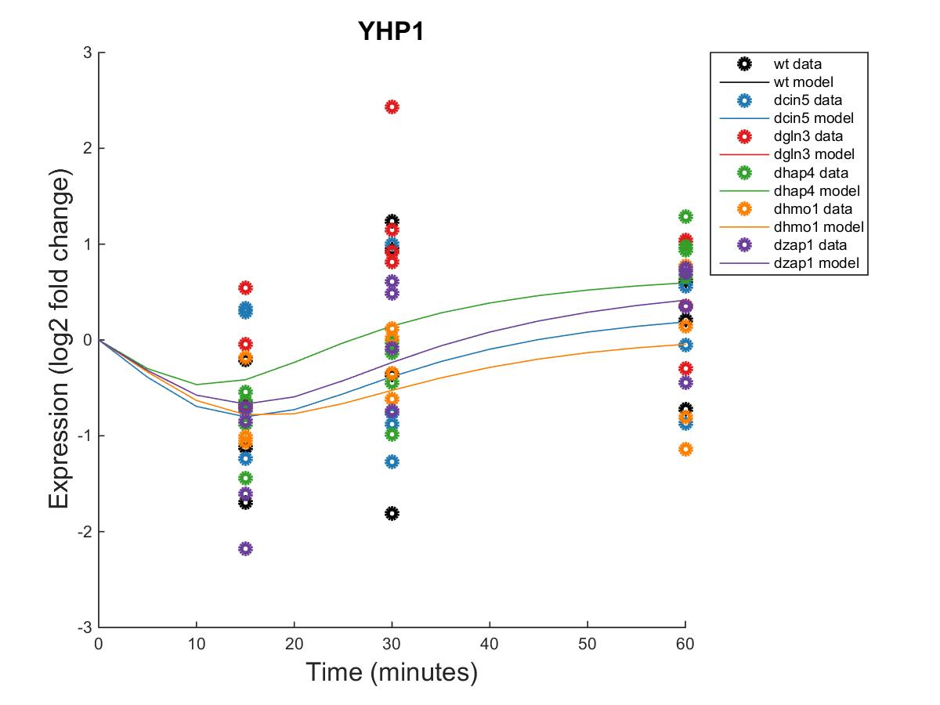
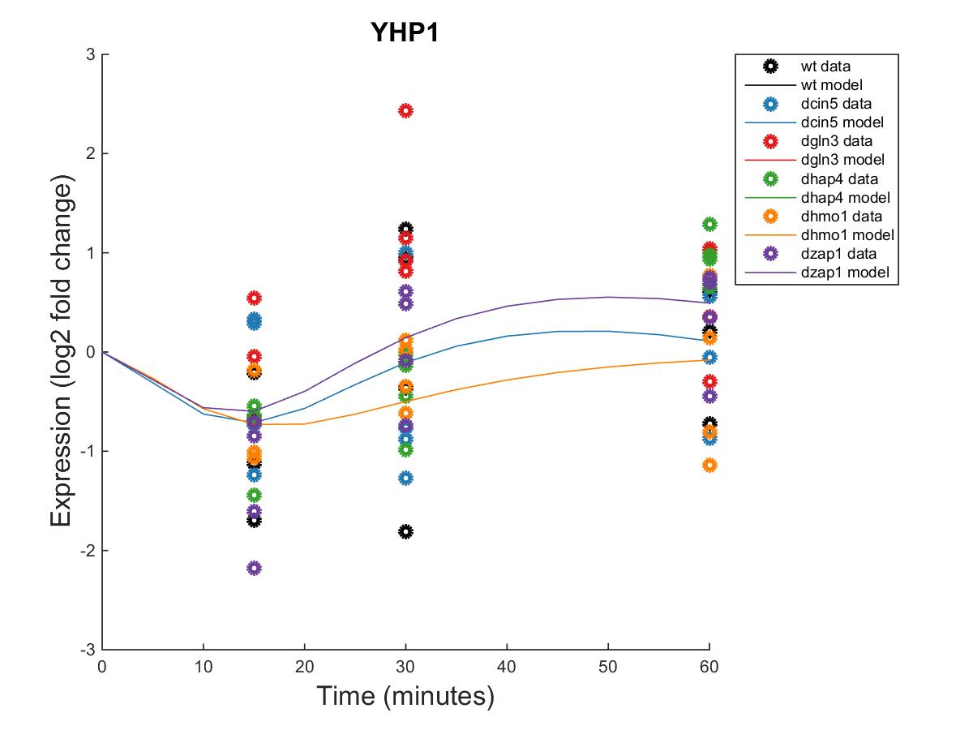
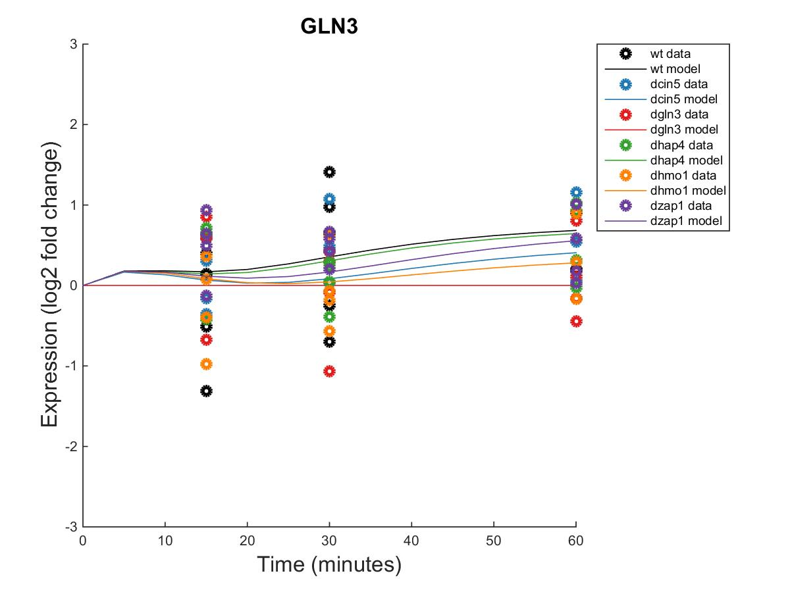
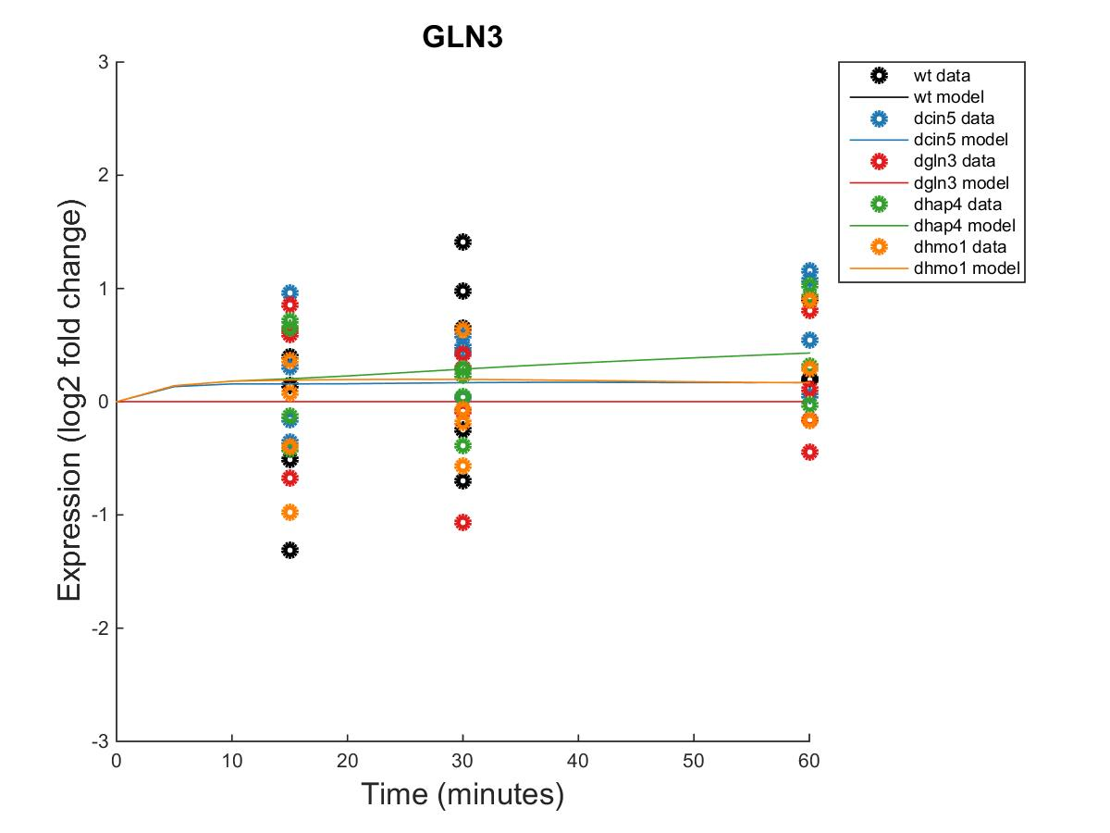
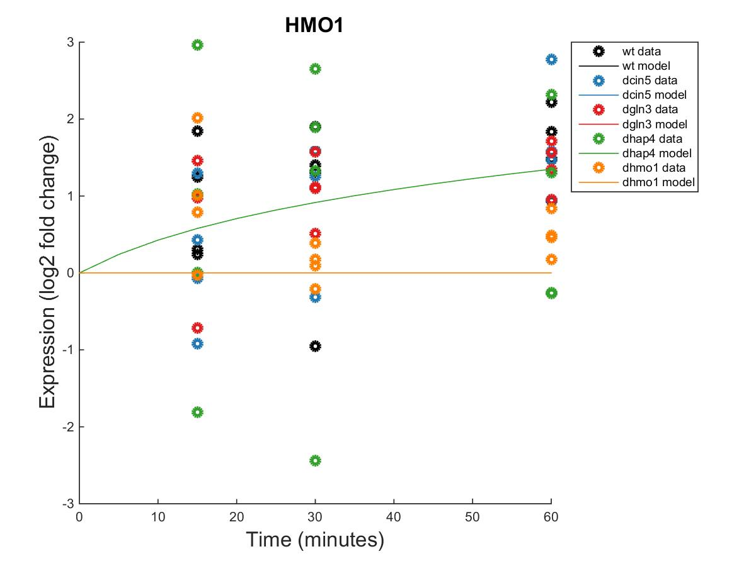

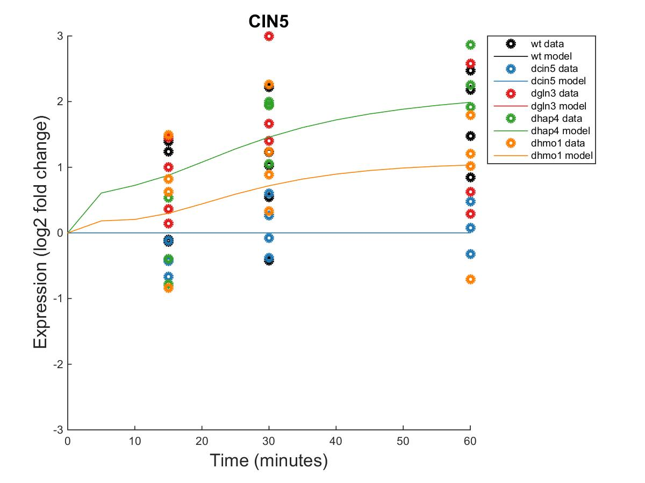

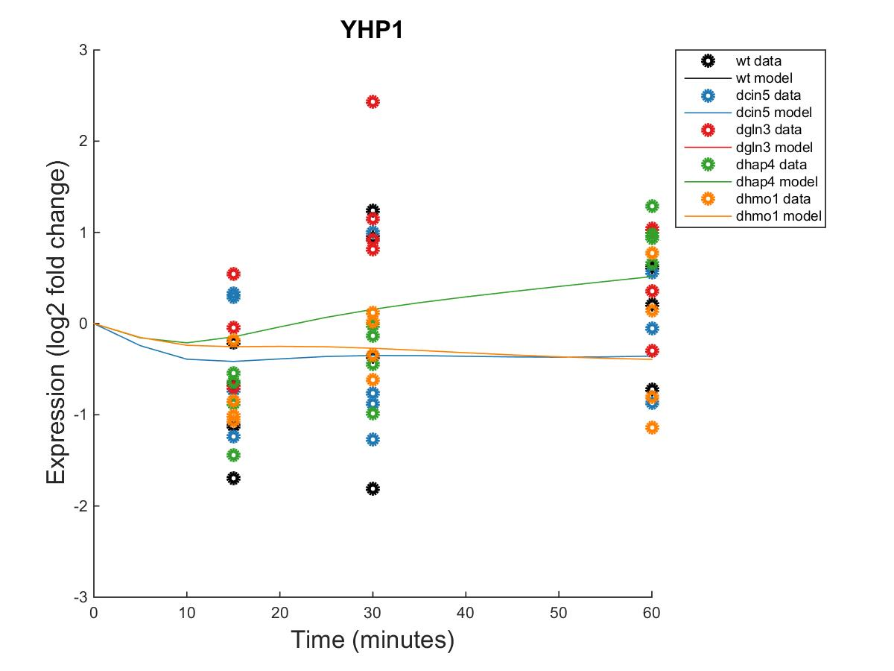
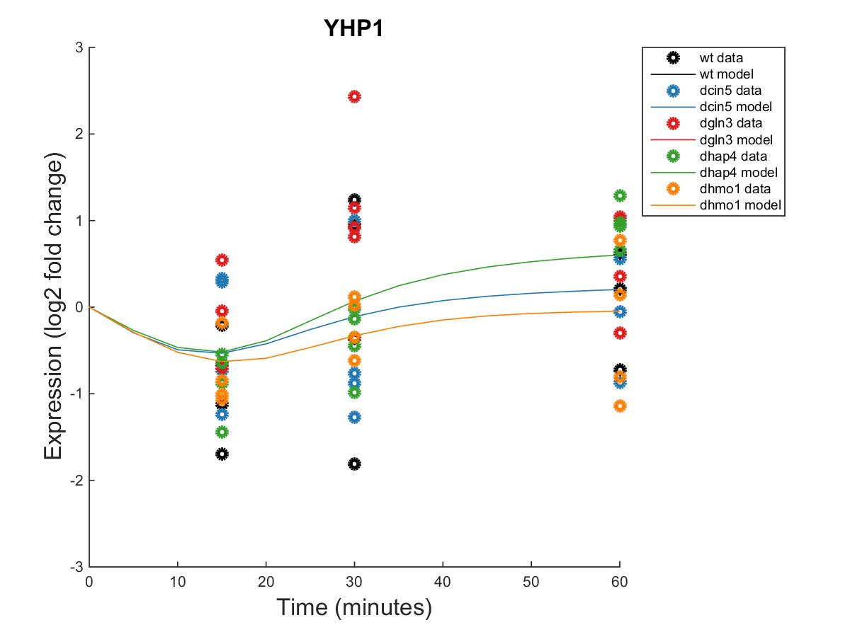
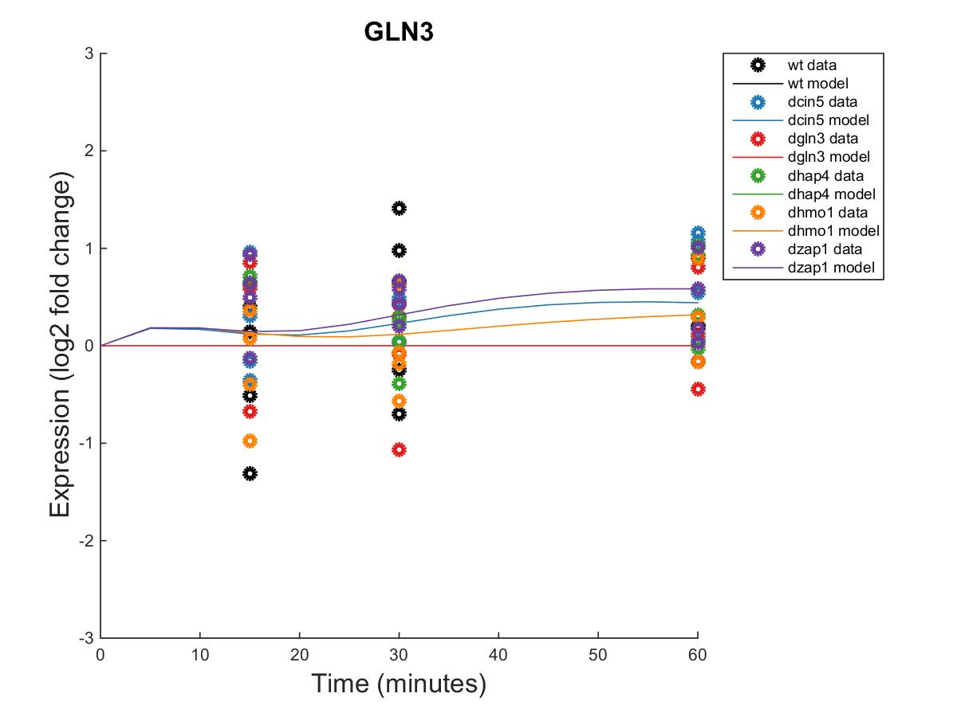
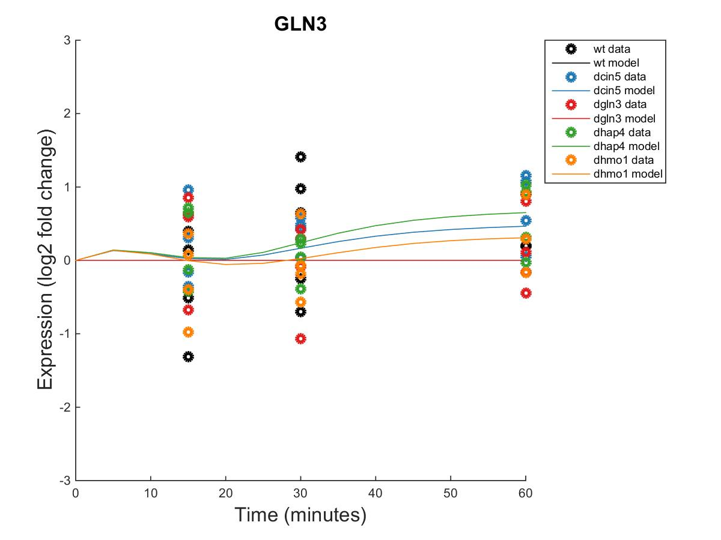
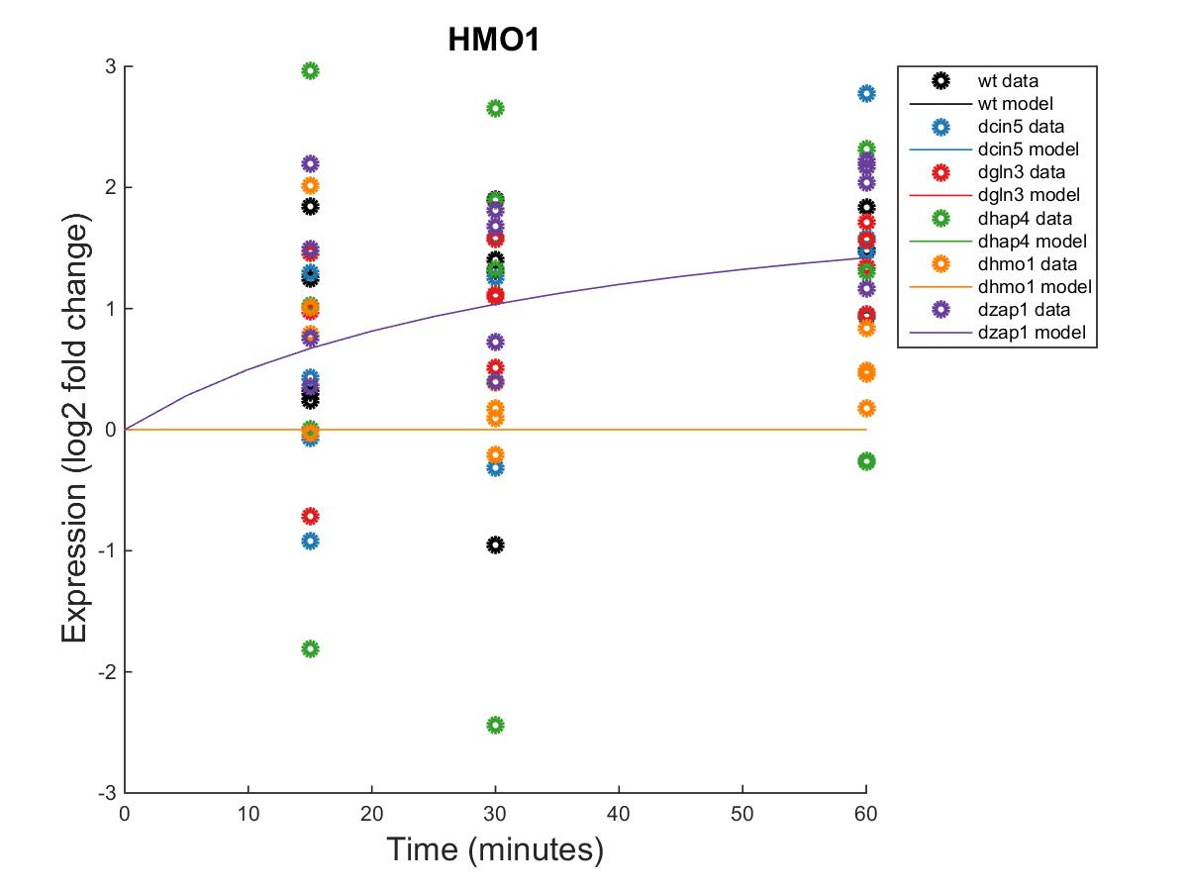
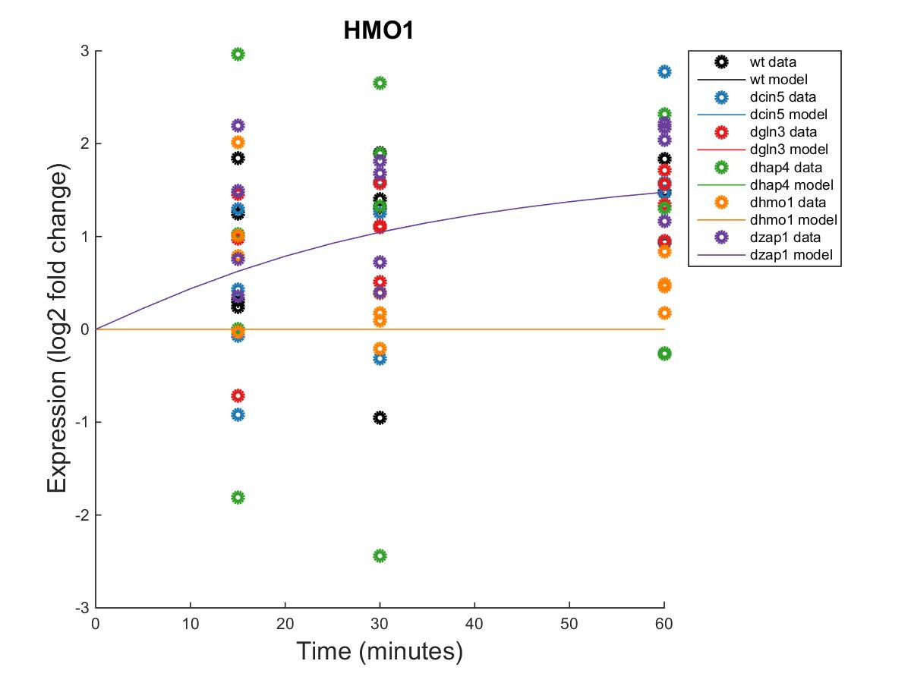


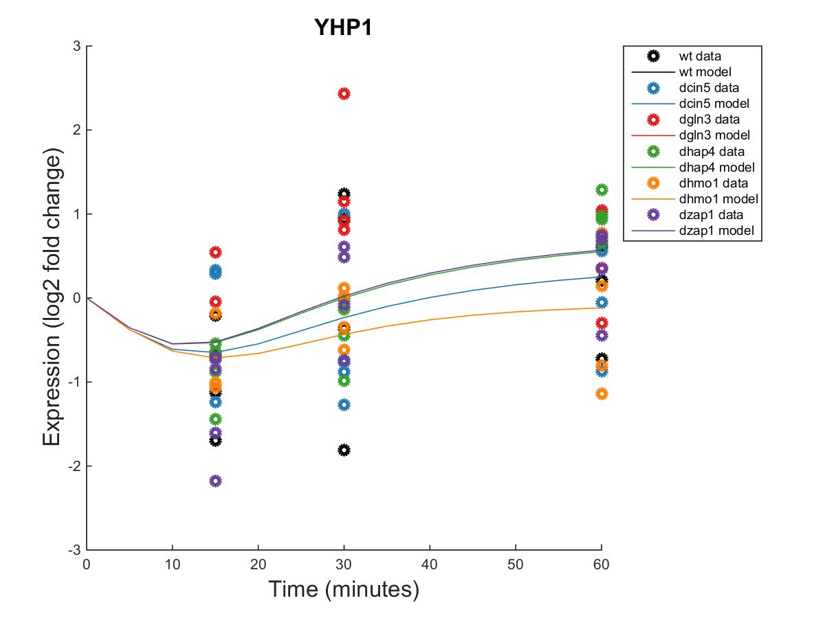

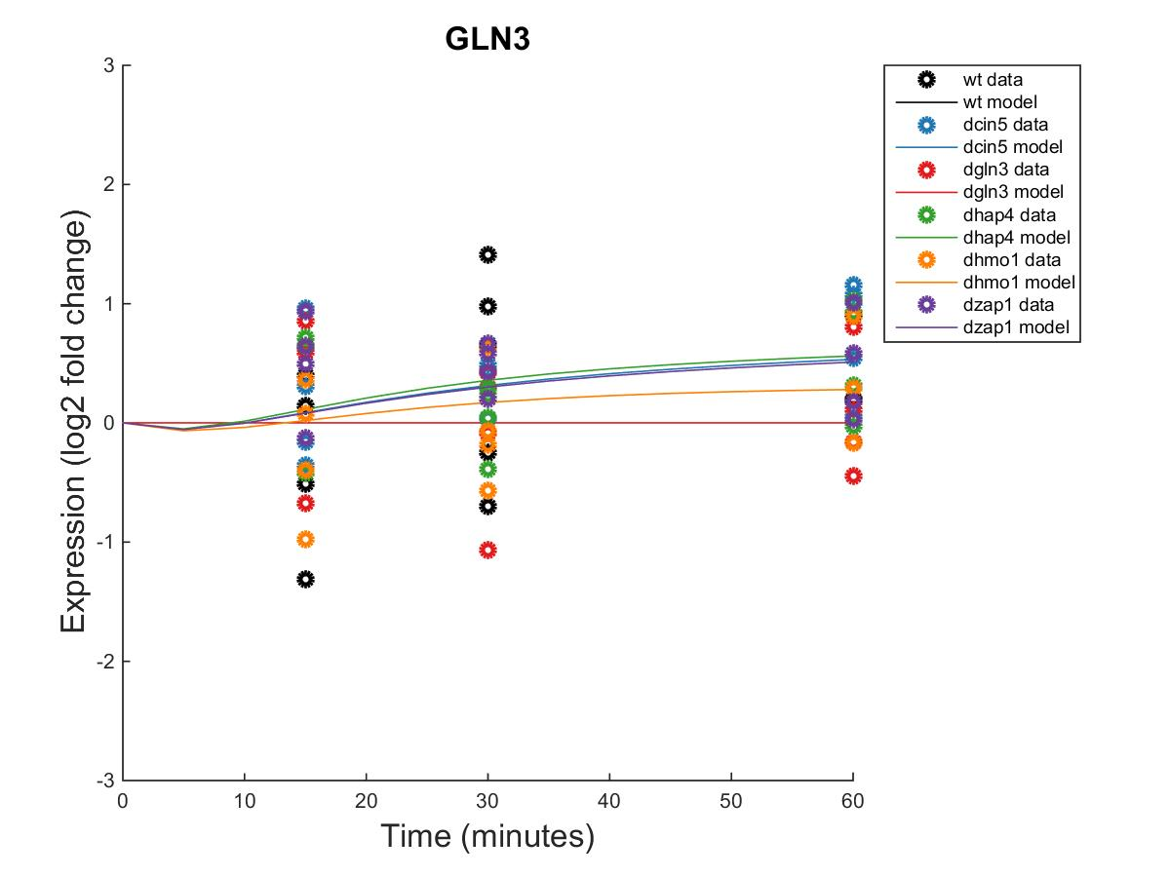

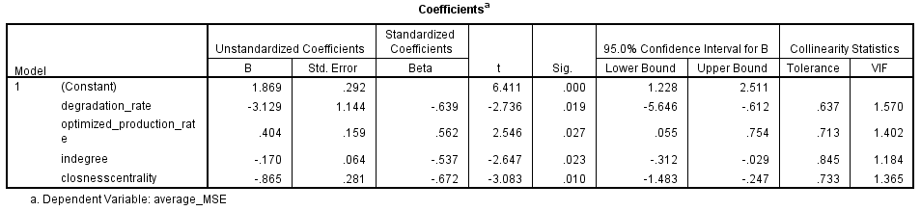
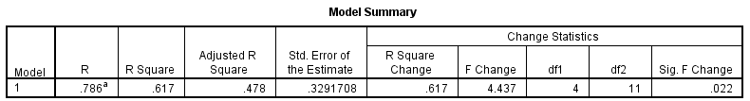
Dynamical systems modeling of six related small gene regulatory networks suggests that the transcription factors
Cin5, Gln3, Hmo1, and Yhp1 play a role in controlling the cold shock response in Saccharomyces cerevisiae
Brandon J. Klein¹, Natalie E. Williams¹, Kam D. Dahlquist¹, and Ben G. Fitzpatrick²
¹Department of Biology, ²Department of Mathematics
Loyola Marymount University, 1 LMU Drive, Los Angeles, CA 90045 USA
Transcription Factors Control Gene Expression by Binding to Regulatory DNA Sequences Upstream of Genes
Through Visualization of the Six Networks, GRNsight Highlighted a Key Regulatory Motif Found in Five of the Six Database-Derived GRNs
Activators increase gene expression.
Repressors decrease gene expression.
Transcription factors are themselves proteins that are encoded by genes.
A gene regulatory network (GRN) consists of a set of transcription factors that regulate the level of expression of a set of target genes.
The dynamics of a GRN model how the expression of genes in the network change over time.
1. Network derived from wt data
16 genes, 36 edges
2. Network derived from ∆cin5 data
14 genes, 25 edges
3. Network derived from ∆cin5 data
17 genes, 32 edges
4. Network derived from ∆gln3 data
14 genes, 35 edges
5. Network derived from ∆hap4 data
15 genes, 28 edges
6. Network derived from ∆zap1 data
16 genes, 27 edges
Yeast Respond to the Environmental Stress of Cold Shock
by Altering Gene Expression
Little is known about which transcription factors regulate this response.
The Dahlquist Lab studies the global transcriptional response to cold shock using DNA microarrays, which measure the level of mRNA expression for all 6189 yeast genes.
We have collected expression data from the wild type strain and five transcription factor deletion strains (Δcin5, Δgln3, Δhmo1, Δzap1, Δhap4 ) before cold shock at 30°C and after 15, 30, and 60 minutes of cold shock at 13°C.
Network | LSE:minLSE ratio
db1 | 1.4206
db2 | 1.3580
db3 | 1.4100
db4 | 1.3000
db5 | 1.4263
db6 | 1.3973
GRNsight automatically generates weighted network graphs from the output produced by GRNmap.
The absolute value of the weight parameters are divided by the largest value, which distributes them between 0 and 1. Line thickness is on a linear scale with thin lines near 0 and thick lines near 1.
Positive weights are colored magenta to indicate activation; negative weights are colored cyan to indicate repression. Weights within 0.05 of zero are colored grey to denote negligible influence on the target gene.
The ratio between the least squares error and the theoretical minimum least squares error for each network computed. The closer the value is to one, the better GRNmap performed in modeling the GRN.
Δyap1, replicate 1, 06/23/15
Changes in the Expression of Cin5, Gln3, Hmo1, and Yhp1 were Well Modeled and Demonstrate Sequential Activation
HMO1
CIN5
YHP1
db1
GLN3
db1
db2
db1
db2
Microarray Data from the Dahlquist Lab Was Used to Derive
a Family of Related GRNs from the YEASTRACT Database
db1
db2
db2
Network 1
Network 2
Within Strain ANOVA Benjamini and Hochberg Corrected p values
 | HMO1 | CIN5 | YHP1 | GLN3
Wild-Type | 0.0397 | 0.0662 | 0.1743 | 0.4189
∆cin5 | 0.0022 | — | 0.8684 | 0.5468
∆gln3 | 0.0025 | 0.0163 | 0.0433 | 0.6094
∆hap4 | 0.4244 | 0.0112 | 0.8152 | 0.5189
∆hmo1 | — | 0.4113 | 0.8152 | 0.9281
∆zap1 | 0.0011 | 0.026 | 0.0653 | 0.1171
DNA microarray data for each of the six strains was analyzed to show which genes exhibited significant changes in expression during cold shock. The criteria for significance was a corrected Benjamini & Hochberg (B&H) p value < 0.05.
The genes with significant expression changes were submitted to the YEASTRACT database, which returned a list of transcription factors that could regulate those targets.
Transcription factors for which we had deletion strain microarray data were added to the list of the most significant regulators for each strain to generate six GRNs.
Transcription factors and edges were removed from each GRN in a stepwise fashion in order of least to most significant until the network was pared down to have fewer than 20 genes.
Each of the pared-down GRNs, labeled db1-db6, were input into the Dahlquist lab’s GRNmap program to model the dynamics of each gene’s expression in their respective networks.
db3
db4
db3
db4
Strain | Wild-type | ∆cin5 | ∆gln3 | ∆hap4 | ∆zap1
Significant genes | 1936 (31%) | 1683 (28%) | 1683 (28%) | 1794 (29%) | 1859 (30%)
db3
db4
db3
db4
Network 3
Network 4
Variability in expression dynamics appears directly proportional to corrected p-values.
Ordering the transcription factors as they appear in the motif suggests a sequential response of these genes to cold shock.
db5
db6
db5
db6
db5
db5
db6
Network 5
Modeling of the GRNs Revealed Consistent Regulatory Relationships Among a Series of Transcription Factors
Graph Statistics Demonstrate that the Transcription Factors in this Motif Exhibit a
High Degree of Influence on the Overall GRNs
Conclusions and Future Directions
Outdegree
Eigenvector Centrality
By analyzing GRNmap output data and employing GRNsight visualization, a circuit involving the transcription factors Hmo1, Cin5, Yhp1, and Gln3 was identified. These genes regulate the progression of yeast’s cell cycle as a response to cold shock.
Hmo1 plays a role in genome maintenance by regulating transcription of RNAs. Cin5 is a leucine-zipper and guides TUP1, a stress response gene, to its targets. Yhp1 represses genes involved in M/G1 transition by binding to their promoter region, the early cell cycle box. Finally, Gln3 activates genes regulated by nitrogen catabolite repression and, when expressed at high levels, results in a slow growth phenotype. The LSE and the ratio of output LSE to theoretical minimum LSE for each network demonstrated that the model works consistently for this range of network sizes.
Multiple regression analysis of GRNmap outputs and graph statistics for the wild-type network (db1) indicated that nodes with high indegrees and closeness centralities were more effectively modeled by GRNmap. Further, transcription factors with both fixed and estimated parameters that kept their concentrations low were better modeled, which is consistent with our empirical understanding of transcription factor dynamics in the cell.
Future directions include performing multiple regression analyses using data from db2-db6. Analysis of these test results will allow us to better understand what factors impact how well individual transcription factors are modeled.
We would also like to compare GRNmap’s optimized production rates to published rates, giving us more confidence in the model’s capacity to generate parameters.
 | db1 | db2 | db3 | db4 | db5 | db6 |  | db1 | db2 | db3 | db4 | db5 | db6
ABF1->ASF1 |  |  |  |  |  |  | MCM1->SWI4
ABF1->ASH1 |  |  |  |  |  |  | MCM1->SWI5
ABF1->CST6 |  |  |  |  |  |  | MCM1->YHP1
ABF1->HMO1 |  |  |  |  |  |  | MCM1->YOX1
ABF1->MGA2 |  |  |  |  |  |  | MSN2->AFT2
ABF1->MSN4 |  |  |  |  |  |  | MSN2->ASF1
ABF1->SFP1 |  |  |  |  |  |  | MSN2->ASH1
ABF1->SWI4 |  |  |  |  |  |  | MSN2->CIN5
ACE2->ASH1 |  |  |  |  |  |  | MSN2->CYC8
ASH1->YHP1 |  |  |  |  |  |  | MSN2->HAP4
CIN5->ASF1 |  |  |  |  |  |  | MSN2->MSN4
CIN5->CYC8 |  |  |  |  |  |  | MSN2->SFP1
CIN5->HAP4 |  |  |  |  |  |  | MSN2->SWI4
CIN5->SFP1 |  |  |  |  |  |  | MSN2->TEC1
CIN5->STB5 |  |  |  |  |  |  | MSN2->YHP1
CIN5->TEC1 |  |  |  |  |  |  | MSN2->YOX1
CIN5->YHP1 |  |  |  |  |  |  | SFP1->SWI5
GCN4->GLN3 |  |  |  |  |  |  | STB5->HAP4
GLN3->GCN4 |  |  |  |  |  |  | STB5->SFP1
GLN3->MGA2 |  |  |  |  |  |  | SWI4->CYC8
GRC2->MSN2 |  |  |  |  |  |  | SWI4->HAP4
HAP4->GCN4 |  |  |  |  |  |  | SWI4->YHP1
HMO1->ASF1 |  |  |  |  |  |  | SWI4->YOX1
HMO1->CIN5 |  |  |  |  |  |  | SWI5->ASH1
HMO1->CYC8 |  |  |  |  |  |  | SWI5->TEC1
HMO1->GCN4 |  |  |  |  |  |  | TEC1->CIN5
HMO1->HAP4 |  |  |  |  |  |  | TEC1->HAP4
HMO1->HMO1 |  |  |  |  |  |  | TEC1->MSN2
HMO1->HSF1 |  |  |  |  |  |  | TEC1->SFP1
HMO1->MCM1 |  |  |  |  |  |  | TEC1->YHP1
HMO1->MSN2 |  |  |  |  |  |  | YHP1->ASF1
HMO1->MSN4 |  |  |  |  |  |  | YHP1->GLN3
HMO1->TEC1 |  |  |  |  |  |  | YHP1->RDS3
HMO1->YOX1 |  |  |  |  |  |  | ZAP1->ACE2
MCM1->ACE2
Maximum: 1
*
*
*
*
*
Outdegree indicates the number of targets regulated by each transcription factor. The high outdegrees of Cin5 and Hmo1 indicate that these genes connect to various other points in the network outside of this motif.
Eigenvector centrality measures the relative influence of each transcription factor on the overall dynamics of the GRN. The later half of this motif contains the genes Gln3 and Yhp1, which both rank among the highest influencers of their respective GRNs.
*
Multiple Regression Analysis of db1 Highlighted Parameters that Improved the Model Fit for Individual Transcription Factors
Acknowledgments
Minimum : -1
Multiple regression was conducted with the mean squared error for the expression of each gene as the dependent variable.
Predictors included model parameters and graph statistics derived from the GRNs. Stepwise regression was performed via backward elimination.
Genes that were highly regulated were well modeled.
Transcription factors that remained at low concentrations were well modeled.
For their work on the GRNmap code, we would like to thank Trixie Anne M. Roque, Chukwuemeka E. Azinge, and Justin K. Torres. We thank Nicole A. Anguiano, Anindita Varshneya, Mihir Samdarshi, Edward Bachuora, Jen Shin, and Eileen Choe for their work on the GRNsight visualization software. Microarray data were collected by Cybele Arsan, Wesley Citti, Kevin Entzminger, Andrew Herman, Monica Hong, Heather King, Lauren Kubeck, Stephanie Kuelbs, Elizabeth Liu, Matthew Mejia, Kevin McGee, Kenny Rodriguez, Olivia Sakhon, Alondra Vega, and Kevin Wyllie. Further, we would like to thank Kristen M. Horstmann and Margaret J. O’Neil for their contributions to the GRNmap data analysis team. This work was supported by NSF-RUI Award 0921038 (K.D.D., B.G.F.), a Kadner-Pitts Research Grant (K.D.D.), and a Loyola Marymount University Honors Program Summer Fellowship (N.E.W).
*
*
References
Regulatory relationships are written as regulator->target.
Regulatory weights within each network were extracted from GRNmap and normalized to the maximum weight value present within that network.
Positive weight values indicate activation, whereas negative weight values indicate repression.
Abdulrehman, D., Monteiro, P., Teixeira, M., Mira, N., Lourenço, A., Santos, S., Cabrito, T., Francisco, A., Madeira, S., Aires, R., Oliveira, A., Sá-Correia, I., & Freitas, A. (2011). YEASTRACT: providing a programmatic access to curated transcriptional regulatory associations in Saccharomyces cerevisiae through a web services interface Nucl. Acids Res., 39: D136-D140, Oxford University Press.
Dahlquist, K., Fitzpatrick, B., Camacho, E., Entzminger, S., & Wanner, N. (2015). Parameter Estimation for Gene Regulatory Networks from Microarray Data: Cold Shock Response in Saccharomyces cerevisiae. Bulletin Of Mathematical Biology, 77(8), 1457-1492. http://dx.doi.org/10.1007/s11538-015-0092-6.
Dahlquist, K., Dionisio, J.D., Fitzpatrick, B., Anguiano, N., Varshneya, A., Southwick, B., and Sardarshi, M. (2016). GRNsight: a web application and service for visualizing models of small- to medium-scale gene regulatory networks. PeerJ Computer Science, 2:e85 from http://doi.org/10.7717/peerj-cs.85
GRNsight - Home. (n.d.). Retrieved March 10, 2016, from http://dondi.github.io/GRNsight/.
GRNmap – Home.. (n.d.). Retrieved March 10, 2016, from https://github.com/kdahlquist/GRNmap/.
Neymotin, B., Athanasiadou R., and Gresham D. (2014). Determination of in vivo RNA kinetics using RATE-seq. RNA, 20, 1645-1652.

